Slide 2
CoMPAS in next generation substation automation
Rob Tjalma & Sander Jansen
Alliander

Slide 3



Introduction
Rob Tjalma
Software Developer
Experienced in multiple technologies, specialized in Java
Ing Sander Jansen
Product Owner virtual substaions
Background in
Data architecture
Electrical engineering

Slide 4

The world around energy has changed.
Notes:
Renewable energy
Flexibility
Due to the Energy Transition the use of power transmission and distribution grids is changing. The control architecture of power grids needs to be swiftly adapted to take account of infeed at lower grid levels, higher dynamics in flow patterns and more distributed controls (both internal controls and grid flexibility services from third parties).
Talking Points:
Disruption is what happens to people who don’t forecast what’s about to happen.
Transformation is better.
- The world around energy has changed
- It’s simultaneously opening opportunities like we’ve never seen before for those that change with it, as it rapidly erodes the relevance of those that don’t embrace the change
- We’ve seen it in other industries and no one in the energy industry is immune to the change that is happening in our industry.

Slide 5
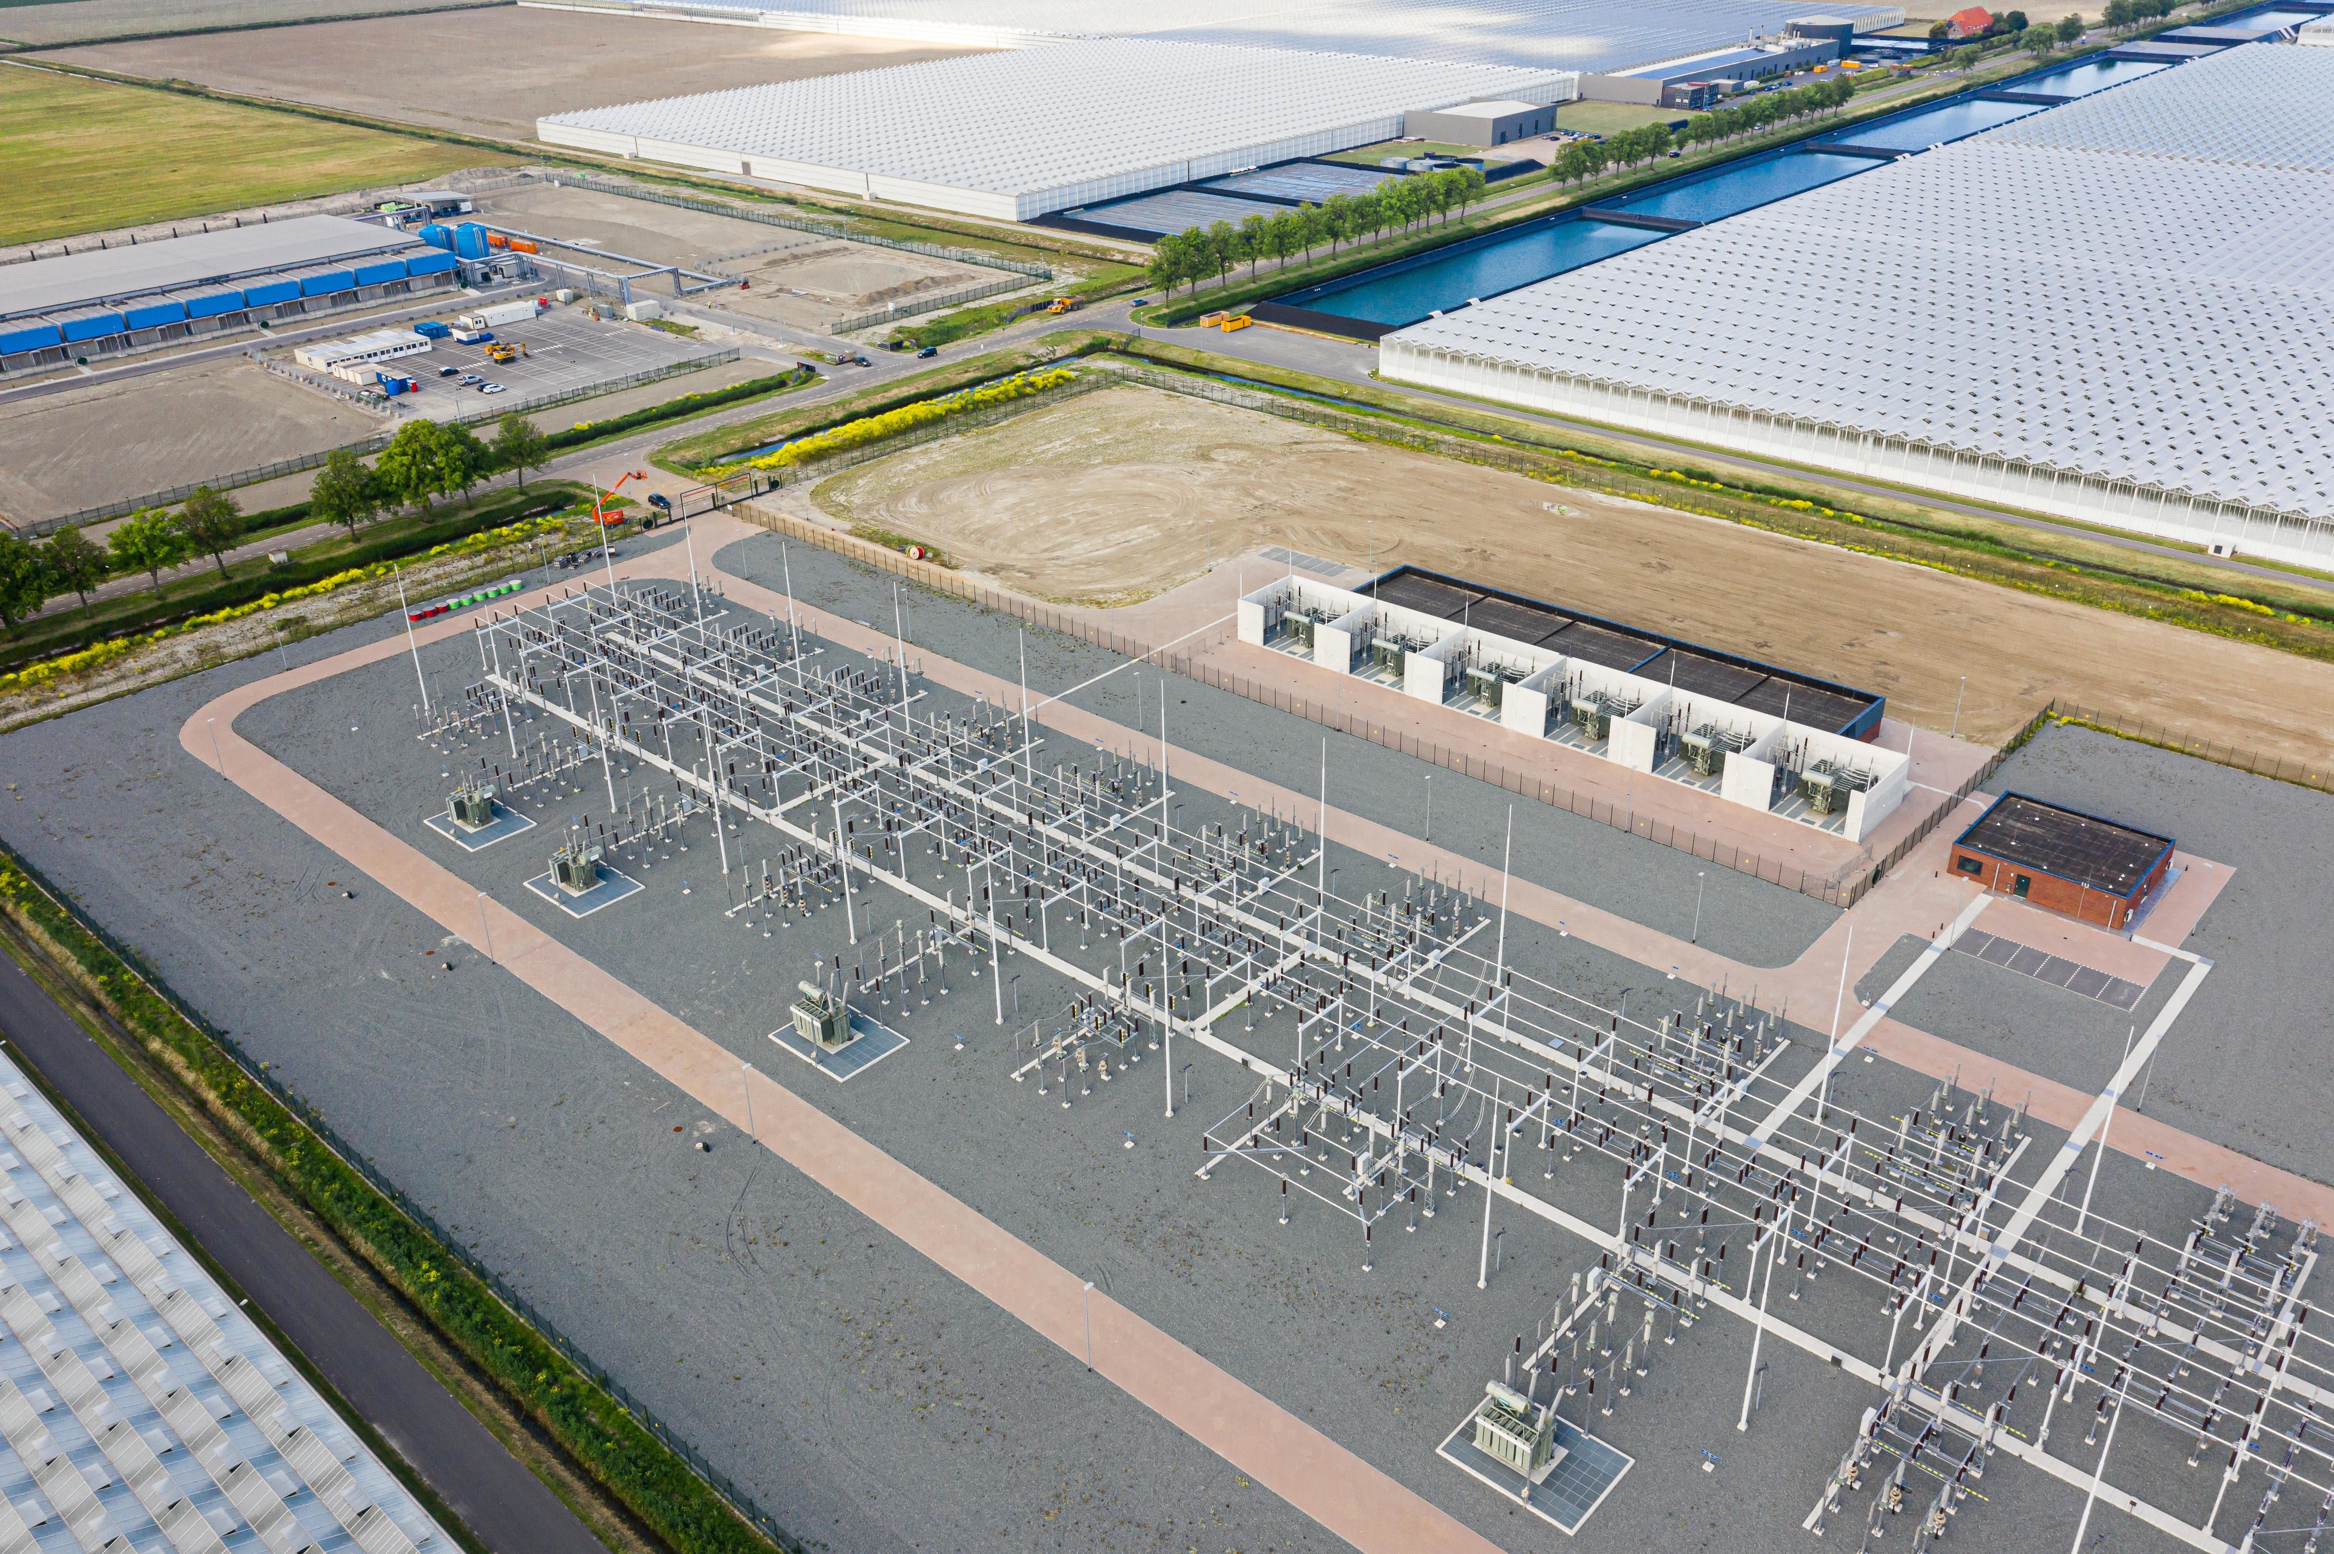
Substation Requirements
Substation of the future requires:
Dynamic protection settings
Adaptive automation functions
Great data management
administration
deployment

Slide 6
Substation
current state and future
Today’s Black Box
Proprietary IED's
Market Disruption
Driving Innovation
Open source based stack
Orchestration
Management
Services/apps
Features/Service Management & Operations
Virtual Functions
Automation
Software-Defined
Disaggregation
Orchestration
Control software Operating System
Software
Operating system
Network
Control Plane CPU
Switch Silicon
Data Plane Silicon
Hardware
Hardware

Slide 7
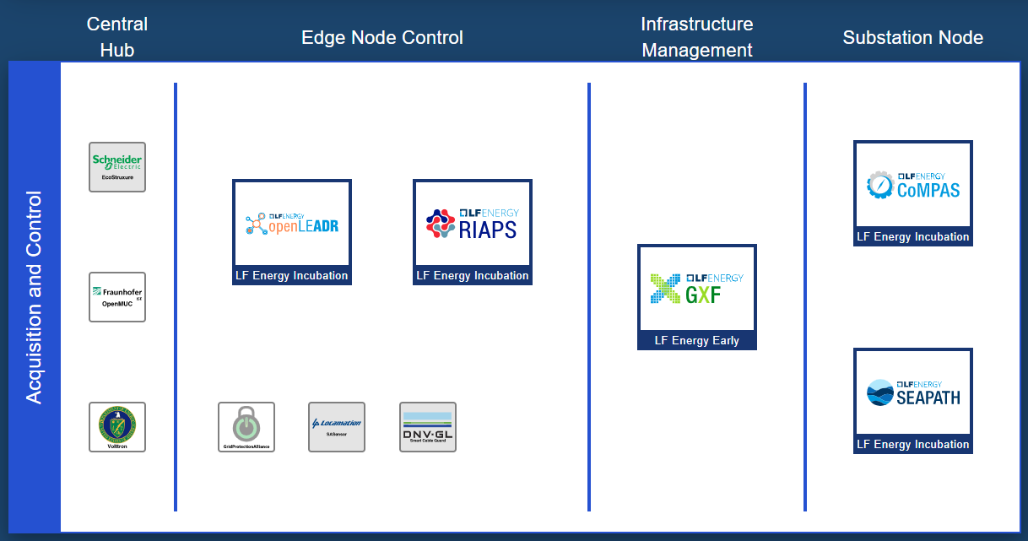
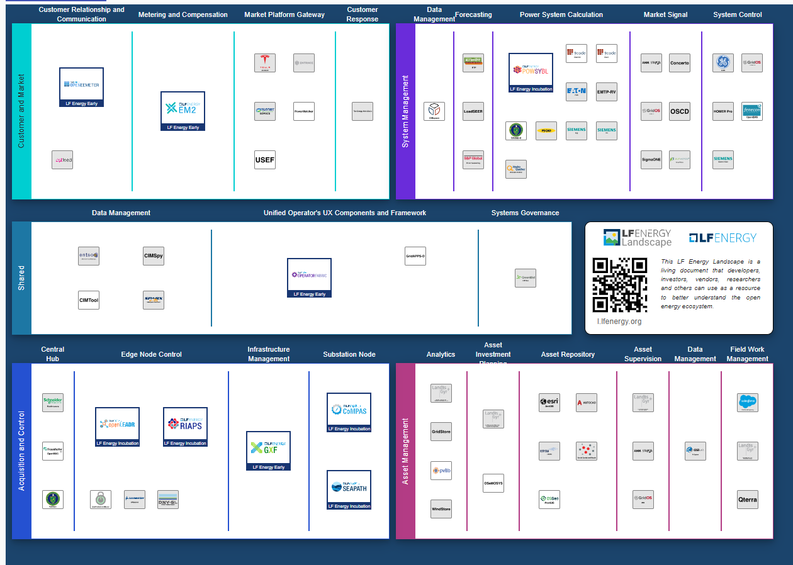
LF energy functional architecture
Source: LF Energy Landscape

Slide 8
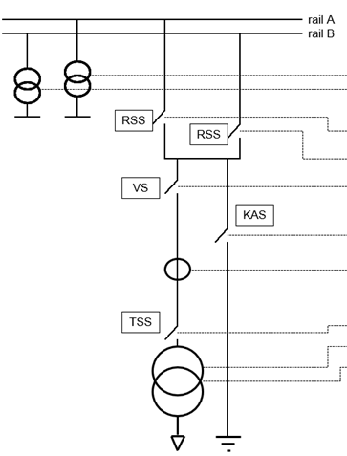



LF energy
Substation architecture
Merging unit / IO / Digital instrument transformer
IEC 61869-13
IEC 61869-9
Substation functions e.g protection
Gateway
Central systems
61850 processbus
61850 stationbus
61850 SCL
Notes:
Seapath komt na ons

Slide 9
CoMPAS goal
The aim of the CoMPAS project is to develop open source software components related to IEC 61850 model implementation (profile management) and configuration of a power industry Protection Automation and Control System (PACS).
Notes:
Faster development and collaboration

Slide 10
CoMPAS use-cases
Requirements specification
Grid planning: CIM to 61850
Operational changes
Asset management planning
Register for substation configurations
Interface for other systems e.g.
SCADA, CMDB, Grid control etc
Facilitate top-down enigeering
Notes:
Why is this important?

Slide 11
CoMPAS roadmap
Functional block / workstream | Priority rank
Reference architecture | High
System Configuration | High
CIM-IEC61850 mapping | Medium
Integration with OpenSCD | Medium
System specification | Low
Profiling | Low
Testing | Low
Functions are mostly based on IEC61850 Substation configuration tool recommendations

Slide 12
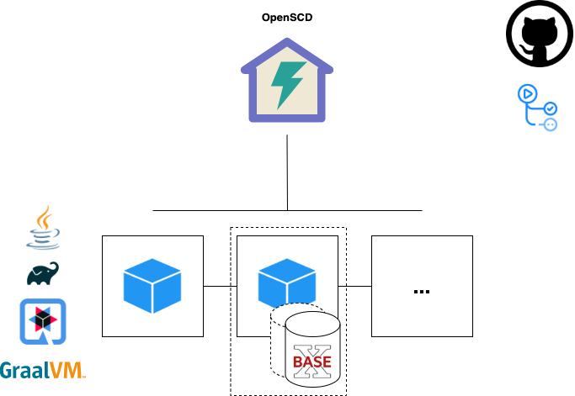
CoMPAS
technical architecture

Slide 13
CoMPAS current state @ time of recording
Active contributors:
RTE
GE
Alliander
Collaboration planned with:
OpenSCD
No release yet
Architecture is ready
https://com-pas.github.io/compas-architecture/
Build/test/documentation in place
https://wiki.lfenergy.org/display/HOME/CoMPAS
Basic CIM to 61850 function
Work on SCT services
(SCD CRUD)

Slide 14


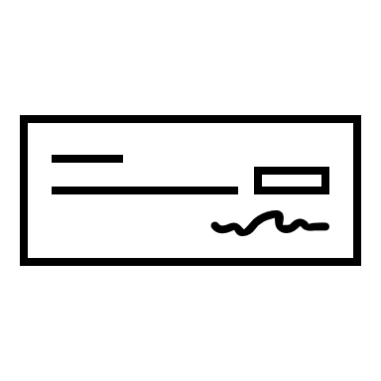
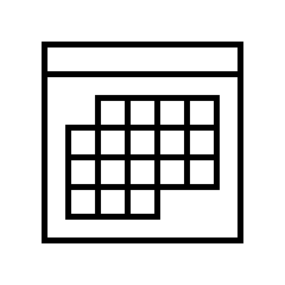
Join the movement!
LF energy slack: #compas
github.com/com-pas
lists.lfenergy.org CoMPAS
Community calls / CoMPAS Architecture · CoMPAS Architecture (com-pas.github.io)

Slide 15
Thank you!
Rob Tjalma & Sander Jansen

